Slide 1
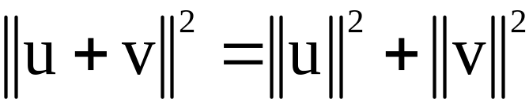


THE PYTHOGOREAN THEOREM
Theorem 2: Two vectors u and v are orthogonal if and only if .
Orthogonal Complements
If a vector z is orthogonal to every vector in a subspace W of , then z is said to be orthogonal to W.
The set of all vectors z that are orthogonal to W is called the orthogonal complement of W and is denoted by (and read as “W perpendicular” or simply “W perp”).
© 2012 Pearson Education, Inc.
Slide 6.1- <number>

Slide 2

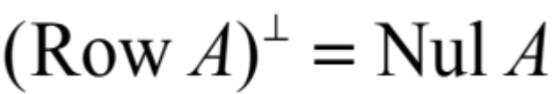
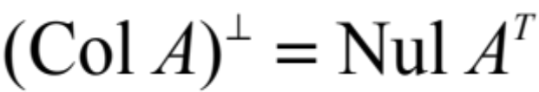
ORTHOGONAL COMPLEMENTS
    A vector x is in if and only if x is orthogonal to every vector in a set that spans W.
    is a subspace of .
Theorem 3: Let A be an matrix. The orthogonal complement of the row space of A is the null space of A, and the orthogonal complement of the column space of A is the null space of A^{T}:
and
© 2012 Pearson Education, Inc.
Slide 6.1- <number>

Slide 3
Orthogonality and Least Squares
ORTHOGONAL SETS
© 2012 Pearson Education, Inc.

Slide 4
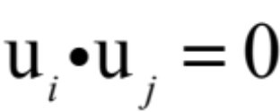

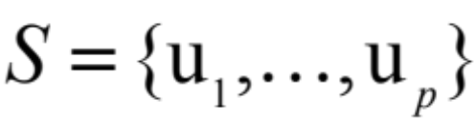
ORTHOGONAL SETS
A set of vectors {u₁,…,u_{p}} in is said to be an orthogonal set if each pair of distinct vectors from the set is orthogonal, that is, if whenever
.
Theorem 4: If is an orthogonal set of nonzero vectors in , then S is linearly independent and hence is a basis for the subspace spanned by S.
© 2012 Pearson Education, Inc.
Slide 6.2- <number>

Slide 5
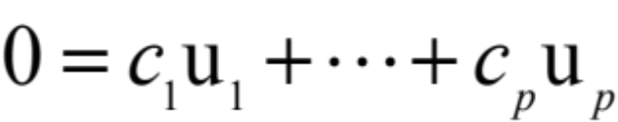
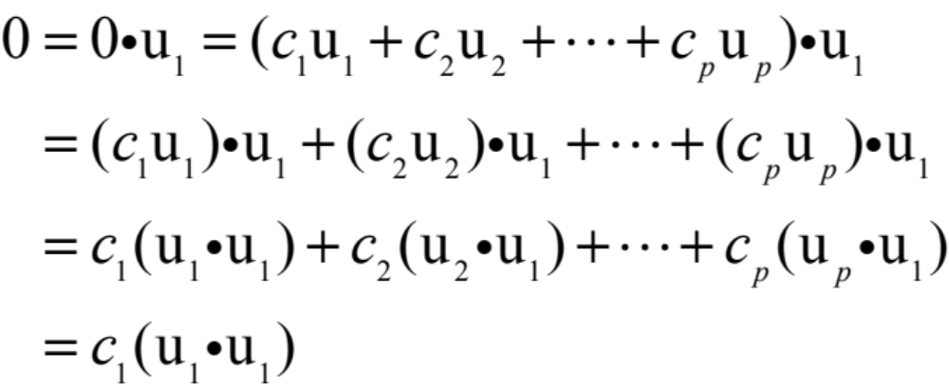
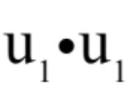
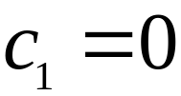
ORTHOGONAL SETS
Proof: If for some scalars c₁,…,c_{p}, then
because u₁ is orthogonal to u₂,…,u_{p}.
Since u₁ is nonzero, is not zero and so .
Similarly, c₂,…,c_{p} must be zero.
© 2012 Pearson Education, Inc.
Slide 6.2- <number>

Slide 6
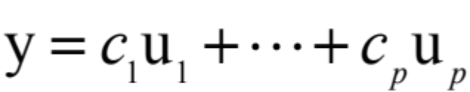
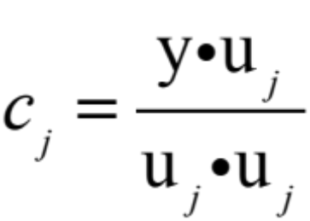

ORTHOGONAL SETS
Thus S is linearly independent.
Definition: An orthogonal basis for a subspace W of is a basis for W that is also an orthogonal set.
Theorem 5: Let {u₁,…,u_{p}} be an orthogonal basis for a subspace W of . For each y in W, the weights in the linear combination
are given by
© 2012 Pearson Education, Inc.
Slide 6.2- <number>

Slide 7

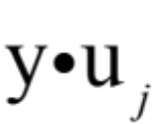
ORTHOGONAL SETS
Proof: The orthogonality of {u₁,…,u_{p}} shows that
Since is not zero, the equation above can be solved for c₁.
To find c_{j} for , compute and solve for c_{j}.
© 2012 Pearson Education, Inc.
Slide 6.2- <number>

Slide 8


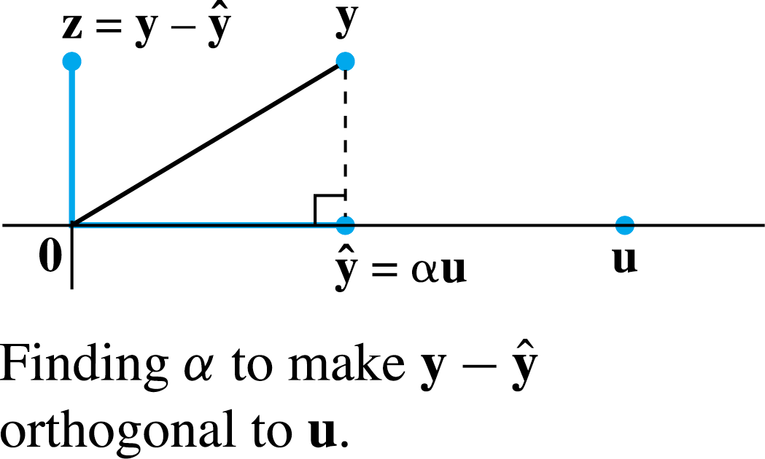
AN ORTHOGONAL PROJECTION
Given a nonzero vector u in , consider the problem of decomposing a vector y in into the sum of two vectors, one a multiple of u and the other orthogonal to u.
We wish to write
----(1)
where for some scalar α and z is some vector orthogonal to u. See the following figure.
© 2012 Pearson Education, Inc.
Slide 6.2- <number>

Slide 9


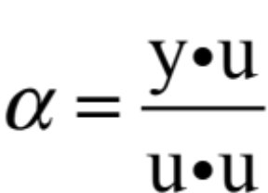
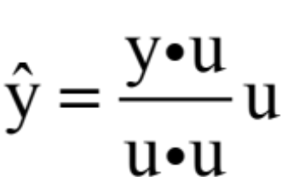

AN ORTHOGONAL PROJECTION
Given any scalar α, let , so that (1) is satisfied.
Then is orthogonal to u if an only if
That is, (1) is satisfied with z orthogonal to u if and
only if and .
The vector is called the orthogonal projection of y onto u, and the vector z is called the component of y orthogonal to u.
© 2012 Pearson Education, Inc.
Slide 6.2- <number>

Slide 10
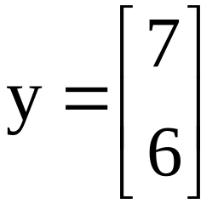
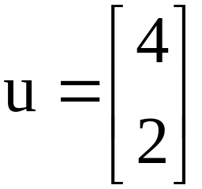
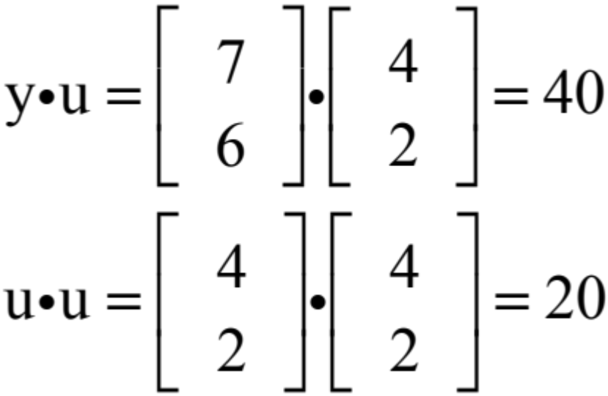
AN ORTHOGONAL PROJECTION
Example 1: Let and . Find the
orthogonal projection of y onto u. Then write y as the sum of two orthogonal vectors, one in Span {u} and one orthogonal to u.
Solution: Compute
© 2012 Pearson Education, Inc.
Slide 6.2- <number>

Slide 11
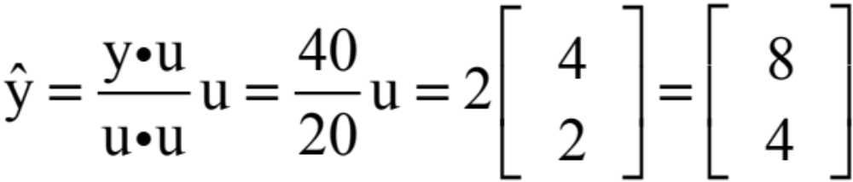
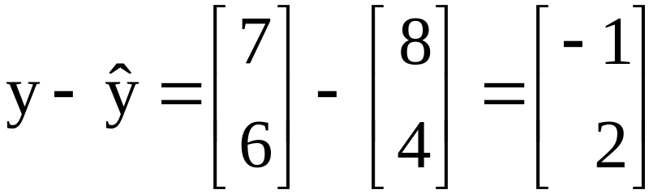
AN ORTHOGONAL PROJECTION
The orthogonal projection of y onto u is
and the component of y orthogonal to u is
The sum of these two vectors is y.
© 2012 Pearson Education, Inc.
Slide 6.2- <number>

Slide 12
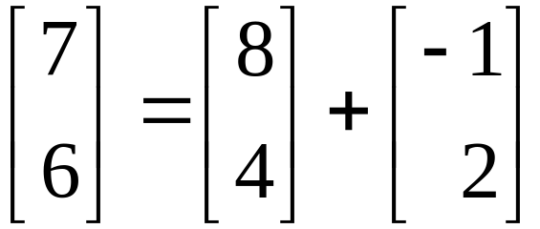



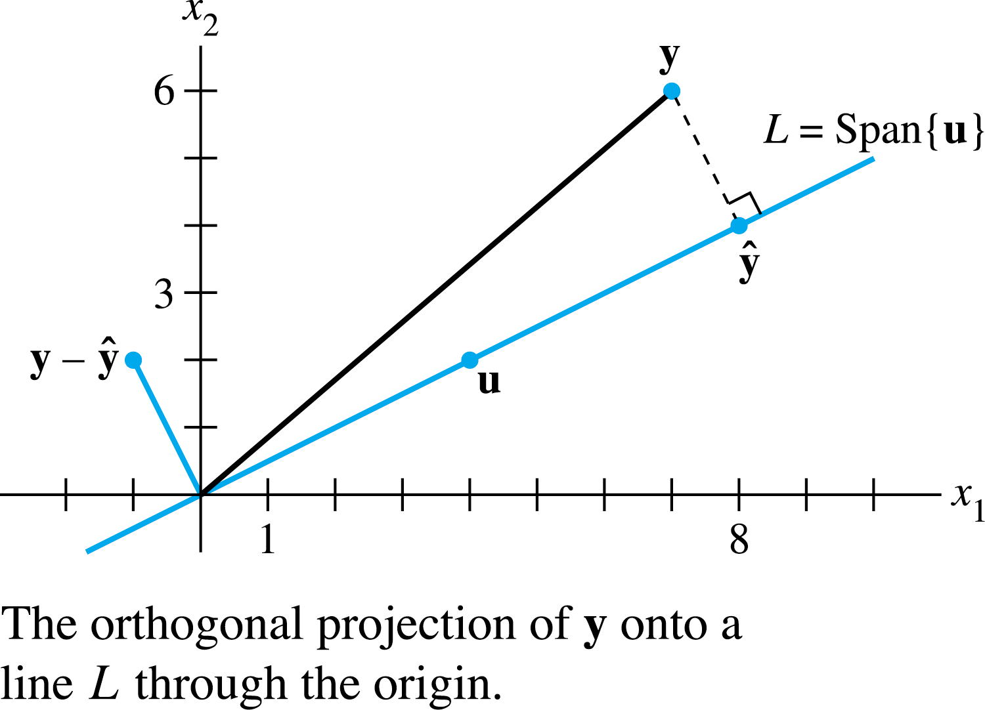
AN ORTHOGONAL PROJECTION
That is,
The decomposition of y is illustrated in the following figure.
© 2012 Pearson Education, Inc.
Slide 6.2- <number>

Slide 13

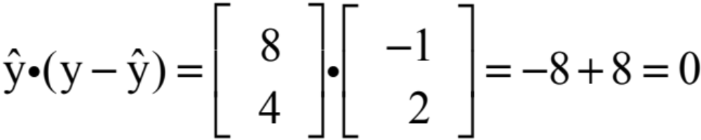
AN ORTHOGONAL PROJECTION
Note: If the calculations above are correct, then will be an orthogonal set.
As a check, compute
Since the line segment in the figure on the previous slide between y and is perpendicular to L, by construction of , the point identified with is the closest point of L to y.
© 2012 Pearson Education, Inc.
Slide 6.2- <number>

Slide 14
ORTHONORMAL SETS
A set {u₁,…,u_{p}} is an orthonormal set if it is an orthogonal set of unit vectors.
If W is the subspace spanned by such a set, then {u₁,…,u_{p}} is an orthonormal basis for W, since the set is automatically linearly independent, by Theorem 4.
© 2012 Pearson Education, Inc.
Slide 6.2- <number>

Slide 15

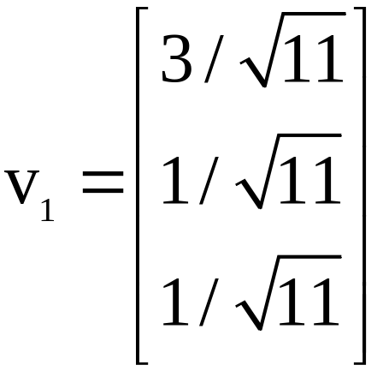
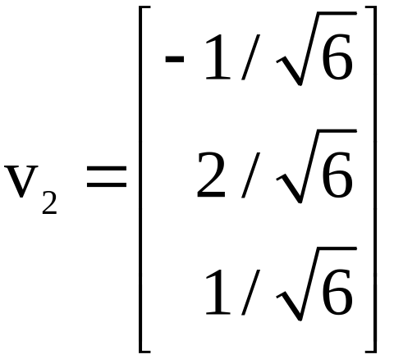
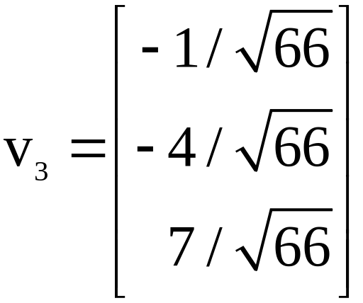
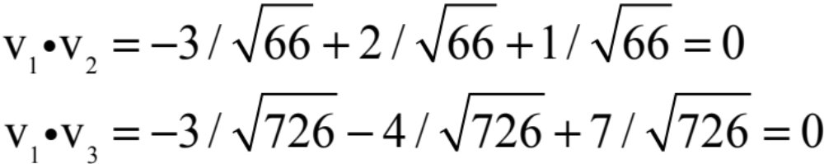
ORTHONORMAL SETS
Example 2: Show that {v₁, v₂, v₃} is an orthonormal basis of , where
, ,
Solution: Compute
© 2012 Pearson Education, Inc.
Slide 6.2- <number>

Slide 16
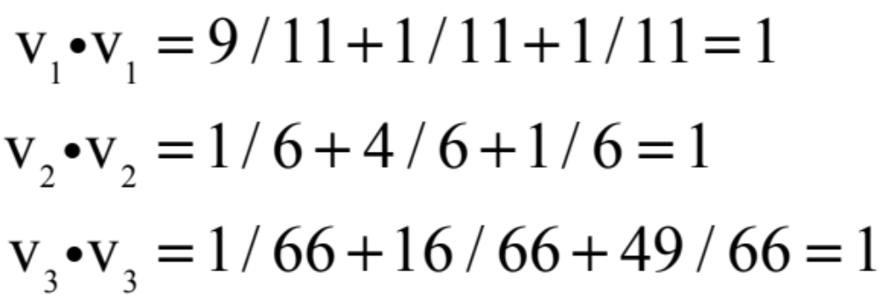
ORTHONORMAL SETS
Thus {v₁, v₂, v₃} is an orthogonal set.
Also,
which shows that v₁, v₂, and v₃ are unit vectors.
Thus {v₁, v₂, v₃} is an orthonormal set.
Since the set is linearly independent, its three vectors form a basis for . See the figure on the next slide.
© 2012 Pearson Education, Inc.
Slide 6.2- <number>

Slide 17
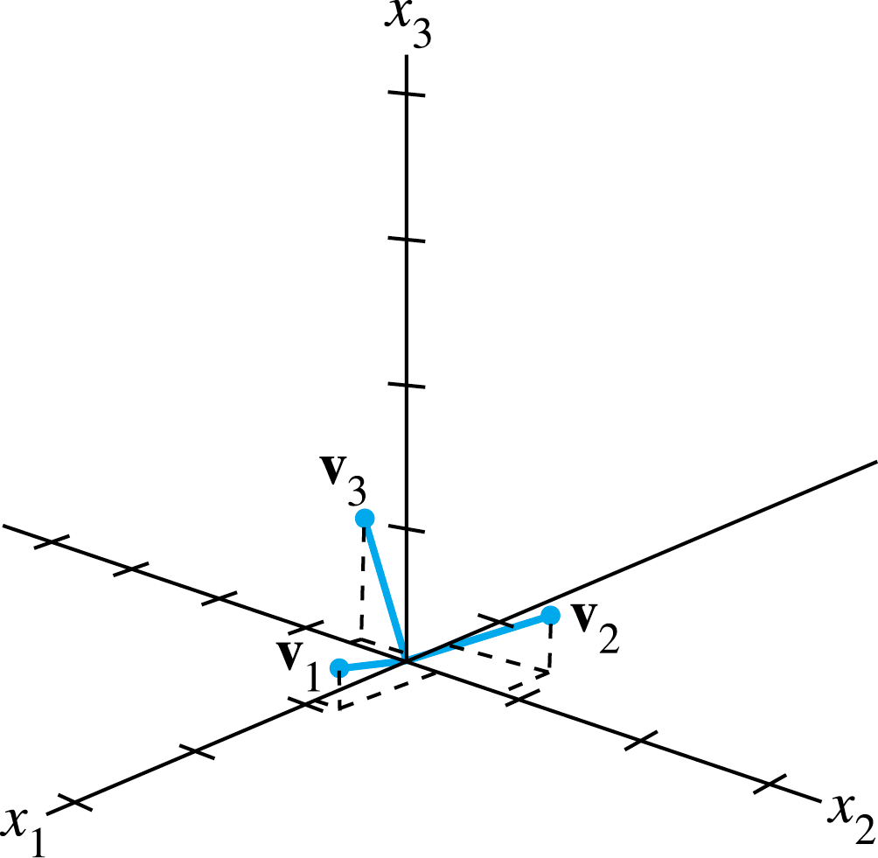
ORTHONORMAL SETS
When the vectors in an orthogonal set of nonzero vectors are normalized to have unit length, the new vectors will still be orthogonal, and hence the new set will be an orthonormal set.
© 2012 Pearson Education, Inc.
Slide 6.2- <number>

Slide 18


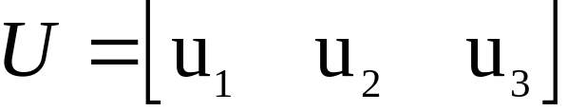
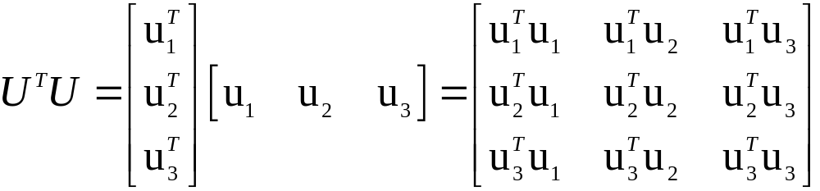
ORTHONORMAL SETS
Theorem 6: An matrix U has orthonormal columns if and only if .
Proof: To simplify notation, we suppose that U has only three columns, each a vector in .
Let and compute
----(3)
© 2012 Pearson Education, Inc.
Slide 6.2- <number>

Slide 19
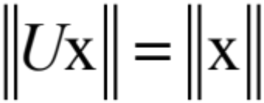




ORTHONORMAL SETS
Theorem 7: Let U be an matrix with orthonormal columns, and let x and y be in .
Then
    if and only if
Properties (a) and (c) say that the linear mapping preserves lengths and orthogonality.
© 2012 Pearson Education, Inc.
Slide 6.2- <number>

Slide 20
Orthogonality and Least Squares
ORTHOGONAL PROJECTIONS
© 2012 Pearson Education, Inc.

Slide 21

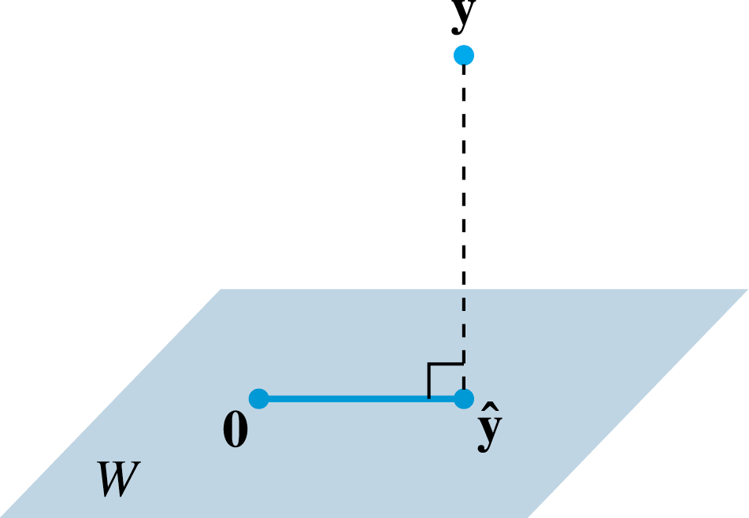
ORTHOGONAL PROJECTIONS
The orthogonal projection of a point in onto a line through the origin has an important analogue in .
Given a vector y and a subspace W in , there is a vector in W such that (1) is the unique vector in W for which is orthogonal to W, and (2) is the unique vector in W closest to y.
© 2012 Pearson Education, Inc.
Slide 6.3- <number>

Slide 22

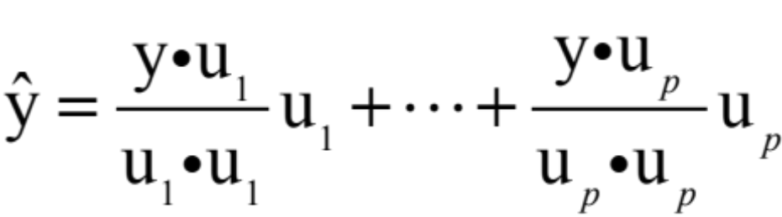

THE ORTHOGONAL DECOMPOSITION THEOREM
These two properties of provide the key to finding the least-squares solutions of linear systems.
Theorem 8: Let W be a subspace of . Then each y in can be written uniquely in the form
----(1)
where is in W and z is in .
In fact, if {u₁,…,u_{p}} is any orthogonal basis of W, then
----(2)
and .
© 2012 Pearson Education, Inc.
Slide 6.3- <number>

Slide 23
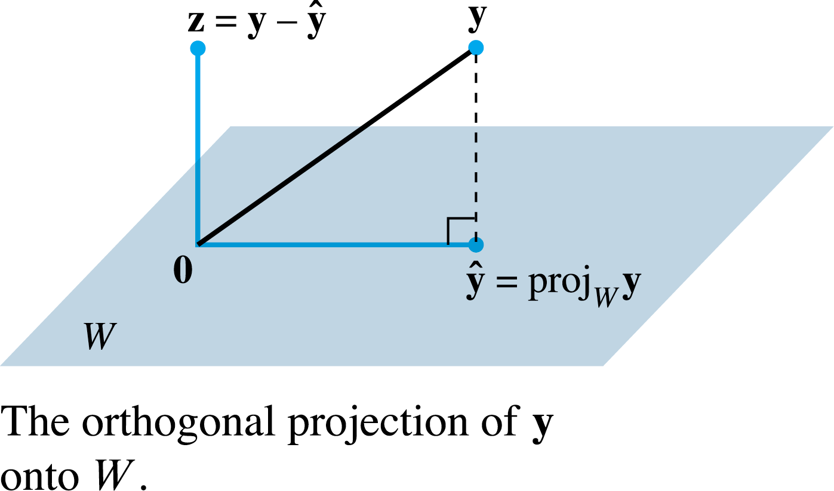
THE ORTHOGONAL DECOMPOSITION THEOREM
The vector in (1) is called the orthogonal projection of y onto W and often is written as proj_{W}y. See the following figure.
Proof: Let {u₁,…,u_{p}} be any orthogonal basis for W, and define by (2).
Then is in W because is a linear combination of the basis u₁,…,u_{p.}
© 2012 Pearson Education, Inc.
Slide 6.3- <number>

Slide 24
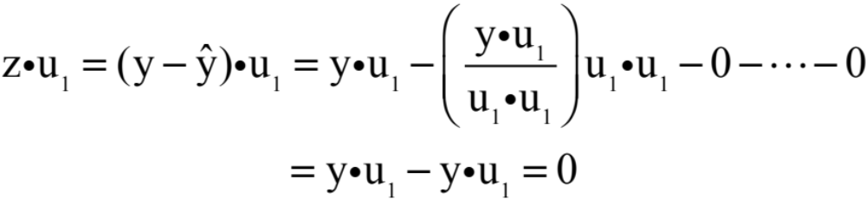
THE ORTHOGONAL DECOMPOSITION THEOREM
Let .
Since u₁ is orthogonal to u₂,…,u_{p}, it follows from (2) that
Thus z is orthogonal to u₁.
Similarly, z is orthogonal to each u_{j} in the basis for W.
Hence z is orthogonal to every vector in W.
That is, z is in .
© 2012 Pearson Education, Inc.
Slide 6.3- <number>

Slide 25
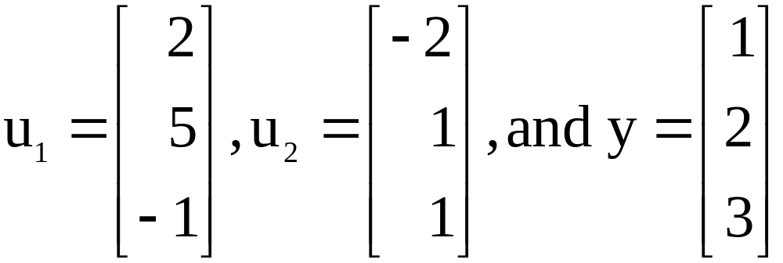
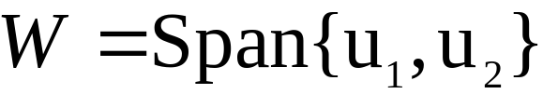
THE ORTHOGONAL DECOMPOSITION THEOREM
The uniqueness of the decomposition (1) shows that the orthogonal projection depends only on W and not on the particular basis used in (2).
Example 1: Let .
Observe that {u₁, u₂} is an orthogonal basis for
. Write y as the sum of a vector in W and a vector orthogonal to W.
© 2012 Pearson Education, Inc.
Slide 6.3- <number>

